Slide 1
Office of School Support Division of School Support School Improvement Informational Presentation and Board Update January 18, 2022
Deowarski McDonald, Ed.D.

Slide 2
Core Values and Commitment
Core Value: Equity
Our vision of equity, put simply, is "all means all." We ensure equity by celebrating each scholar's individuality, interests, abilities and talents; providing each scholar in each school with equitable access to high-quality instruction, courses, and resources; and holding high expectations for all scholars to graduate college-ready and career-minded. Similarly, we recognize and value the individual abilities, experiences and talents of our staff; providing all staff with equitable access to opportunities for development and growth; and ensuring that such opportunities are provided through clear and transparent processes.
Commitment # 2: Innovative Teaching and Learning
Scholars will achieve at high levels when teaching and learning are built around their individual strengths, needs, cultures, interests, and dreams. It is critical that each adult in Jackson Public Schools recognizes each scholar as an individual and ensures equitable learning opportunities that facilitate the development of skills, knowledge, confidence, and voice.

Slide 3
Goals
Background of school improvement
Funding methodology/allocations
School and district requirements

Slide 4
Background
By federal law (ESSA) we are required to identify schools that are identified as Comprehensive Support and Improvement (CSI), Targeted Support and Improvement (TSI), & Additional Targeted Support and Improvement (ATSI) schools beginning with the 2018-19 school year.
Mississippi Code Title 37. Education § 37-18-1. Superior Performing Schools, Exemplary Schools, and Schools At-Risk Programs established.
The MS State Consolidated Plan, also known as MS Succeeds provides the specific criteria for identifying and addressing schools as required by ESSA.

Slide 5
Identifications
Federal Identifications
Comprehensive Support and Improvement (CSI)
Targeted Support and Improvement (TSI)
Additional Targeted Support and Improvement (ATSI)
State Identification
School At-Risk (SAR) Mississippi Identification only

Slide 6
School Improvement Categories
CSI Identification
Graduation rate less than or equal to 67%; OR
Bottom 5% of Title IA schools; OR
Previously identified Additional TSI school with 3 consecutive years of subgroup proficiency performance (no improvement)…ID begins in the 2021-22 School Year
TSI Identification – Underperforming Subgroup
Subgroup in lowest 50% of overall accountability index; AND
Subgroup in lowest quartile of 3-year average gap-to-goal; AND
Subgroup scores in lowest quartile of 3-year improvement toward gap-to-goal closure
Results are rank-ordered and bottom 5% are identified for TSI
ATSI Identification – Consistently Low Performing Subgroup
3-year average subgroup performance is at or below that of all students in the lowest performing schools
SAR Identification
Accountability letter grade of “F”

Slide 7
Federally identified subgroups
Subgroups | Count | Subgroups | Count
All students | 19,687 | Alaskan Native or Native American | 5
Economically disadvantaged students | 19,687 | Asian | 12
Students with disabilities | 2,168 | Black or African American | 18,606
English learners | 454 | Hispanic/Latino | 540
Native Hawaiian or Other Pacific Islander | 0 | White | 270
Two or More Races | 254
* An N count of 10 constitutes a subgroup.

Slide 8
School Improvement Identification Cycle

Slide 9
JPSD Identified Schools
CSI | ATSI | SAR
Blackburn Middle (Lowest 5% of Title I A schools) | *Forest Hill High (Black or African American, Economically Disadvantaged) | Isable Elementary
Brinkley Middle (Lowest 5% of Title I A schools) | *Galloway Elementary (Black or African American, Economically Disadvantaged) | John Hopkins Elementary
Callaway High (Lowest 5% of Title I A schools) | *Green Elementary (Black or African American, Economically Disadvantaged) | Boyd Elementary
Cardozo Middle (Lowest 5% of Title I A schools) | *Jim Hill High (Black or African American, Economically Disadvantaged) | Provine High
Chastain Middle (Lowest 5% of Title I A schools) | *Johnson Elementary (Black or African American, Economically Disadvantaged)
Lanier High (Graduation Rate and Lowest 5% of Title I A Schools) | *Oak Forest Elementary (Black or African American, Economically Disadvantaged)
McLeod Elementary (Lowest 5% of Title I A schools) | Peeples Middle (Black or African American, Economically Disadvantaged, Students w/Disabilities)
Powell Middle (Lowest 5% of Title I A schools) | Van Winkle Elementary/Bates (Black or African American)
Sykes Elementary (Lowest 5% of Title I A schools) | *Wilkins Elementary (Black or African American, Economically Disadvantaged)
Whitten Middle (Lowest 5% of Title I A schools)
Wingfield High (Exited - Graduation Rate)

Slide 10
Funding Methodology
Identification | Allocation
CSI | $100,000.00 each identified year
ATSI | $40,000.00 each identified year
TSI | $40,000.00 each identified year
SAR | No additional federal or state funding
*Per pupil allocations are awarded if funds are remaining once all identified schools statewide receive the base amount.

Slide 11
Jackson Public School District Allocations
Fiscal Year | Allocations
2019 | $1,815,001.00
2020 | $1,870,727.00
2021 | $1,727,833.00
2022 | $1,667,342.00
Budgeting Process and Considerations:
Because these funds are supplemental in nature and will end once a school exits school improvement; we challenge schools to make spending decisions with this end in mind. Plans are developed based on a review of the most recent student data and a review of results from the respective Comprehensive Needs Assessments. Final spending decisions are made in collaboration with input from the building leadership teams, stakeholders, school improvement personnel, Asst. Superintendents and personnel from the Office of School Support.

Slide 12
District School Improvement – Budget Overview (FY21)

Slide 13
District School Improvement – Budget Overview (FY21)

Slide 14
Evidence-based Intervention

Slide 15
Resource Allocation Review
The Every Student Succeeds Act (ESSA) requires that state education agencies (SEAs) conduct periodic resource allocation reviews (RARs) in districts that serve low-performing schools.
This mandate represents a new opportunity for our district to examine the connection between resource allocation and academic outcomes.
What this will look like for us:
Quarterly review of student benchmark data
Quarterly review of funds and fund balances
Review and reflection of data gathered from individual Comprehensive Needs Assessments
Review the impact of funded interventions on student outcomes
Capture and review student data based on subgroups

Slide 16
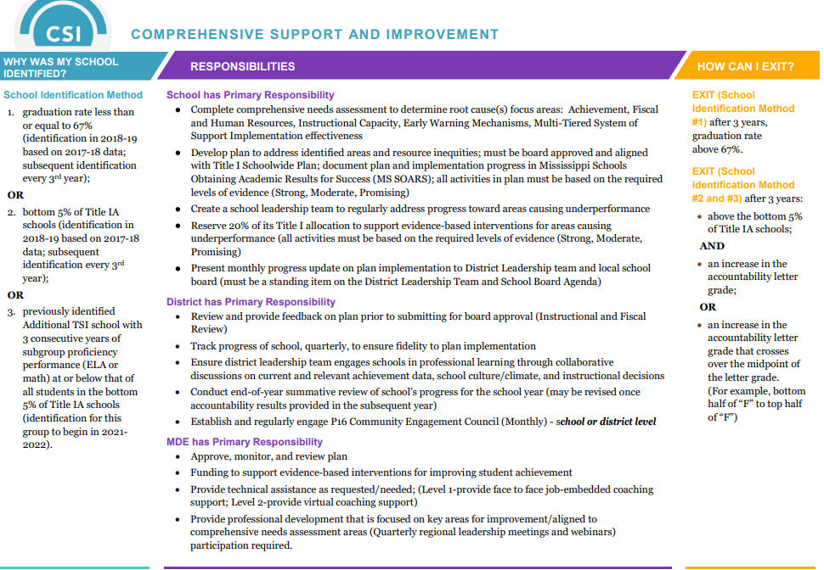
School and District Responsibilities

Slide 17
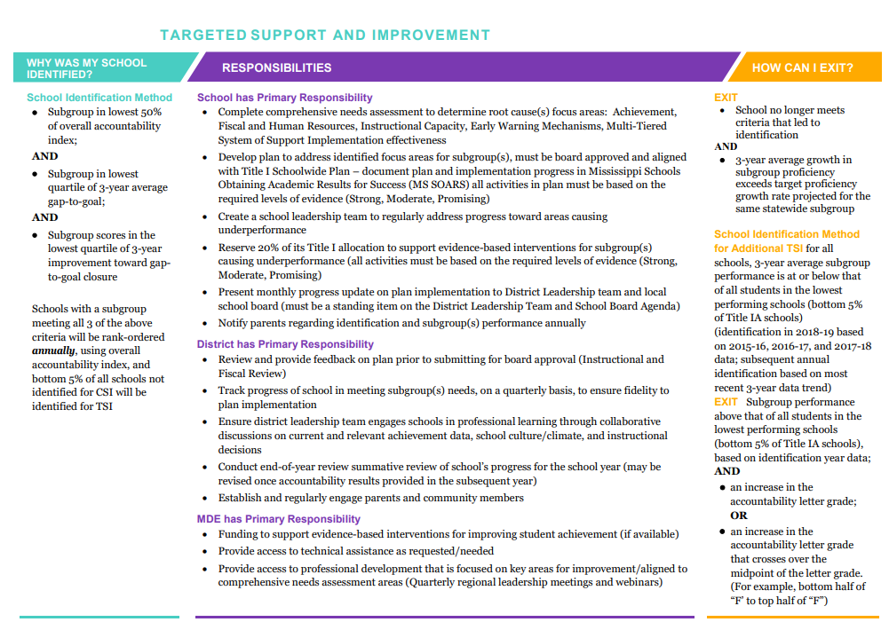
School and District Requirements

Slide 18
School and District Requirements

Slide 19
Next Steps
For information only, a review of proficiency goals, benchmark 1 proficiency data, and student data
For information only, a monthly review of subsequent benchmark data and student data presented based on the school’s identification
Approval of FY22 school improvement plans and budgeted initiatives

Slide 20
Office of School Support
Questions?

Slide 21
When a flower doesn’t bloom, you fix the environment in which it grows, not the flower. Alexander Den Heijer

